Slide 1
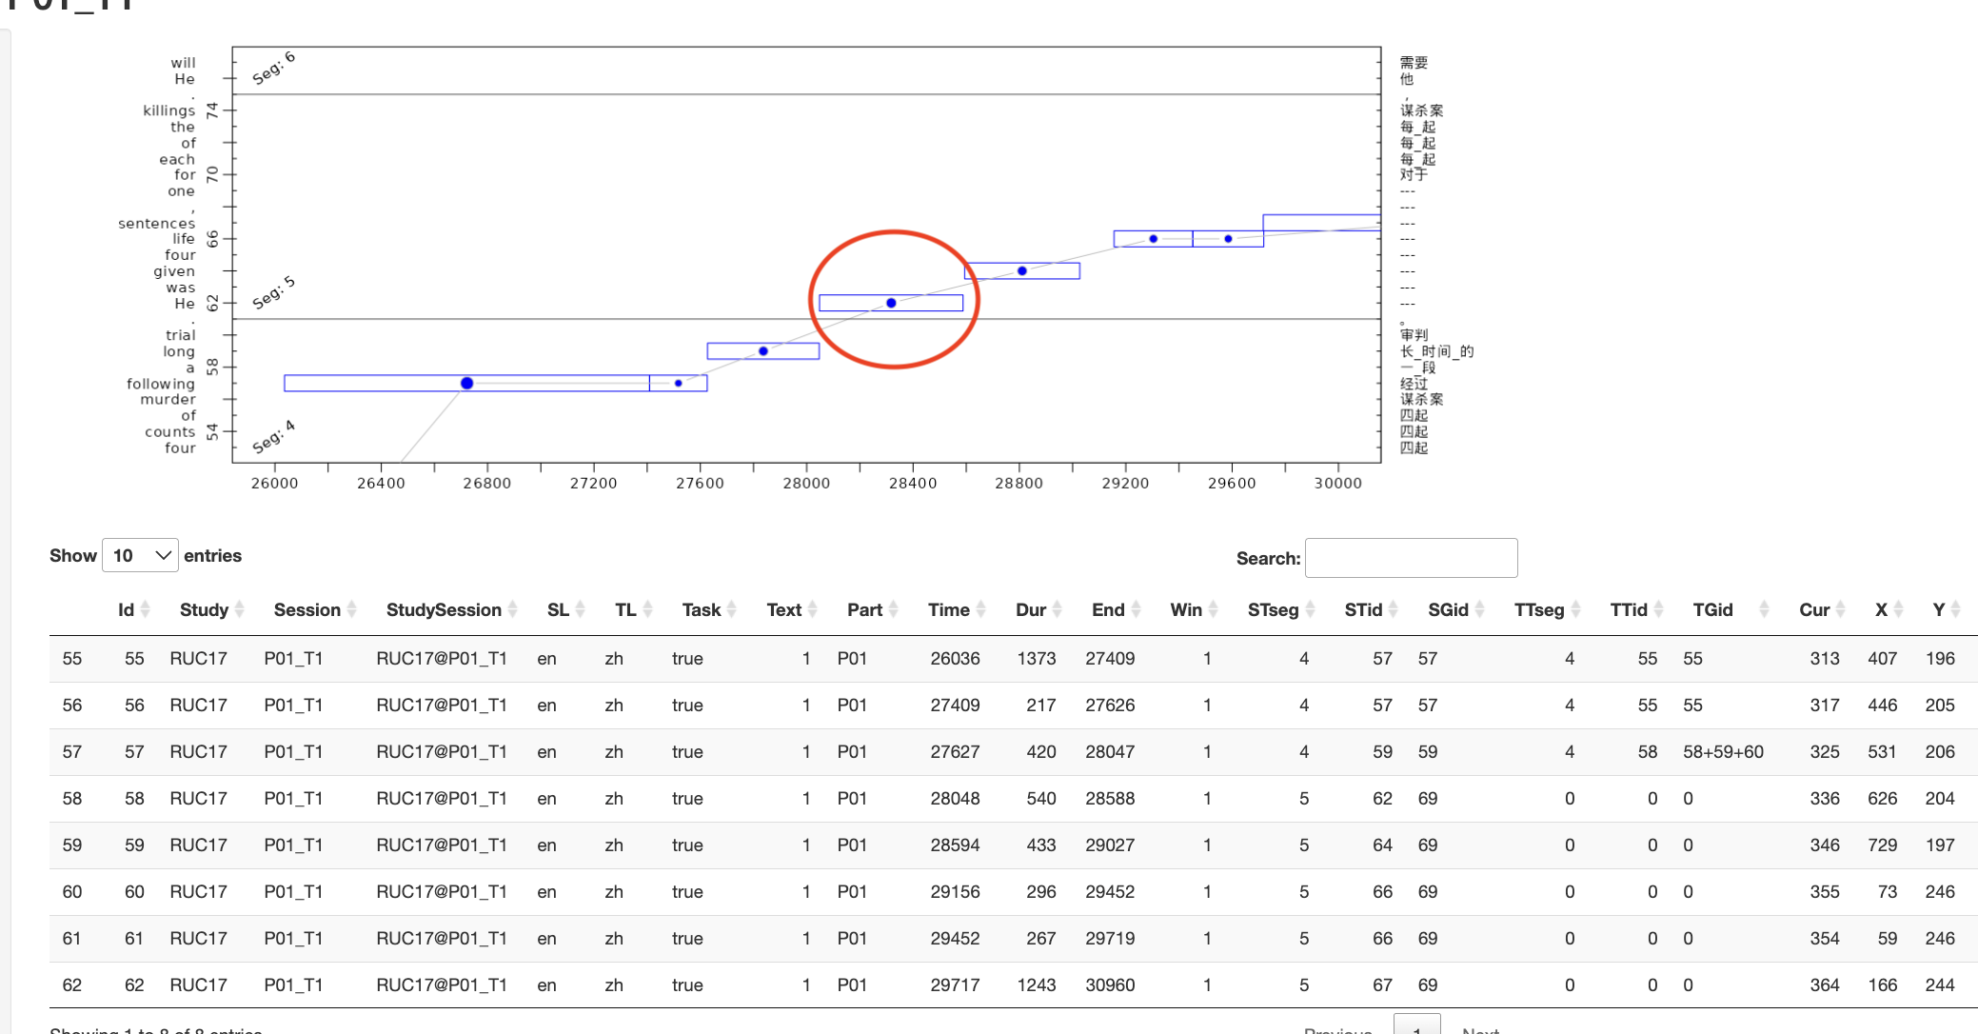
L (linear-reading): 9 (69.23%)
S (Skimming): 3 (23.08%)
R (re-reading): 1 (7.69%)
O (others): 0
Reasons:
L:
“forward, left-to-right”
“sequential, progressive”
“No obvious jumps, no regressions”
“short sequential saccades”
S:
“relatively fast”
“consistent fd”
R:
“back and forth”
BASE_DUR (median of the ST fixations durations): 330.0;
BASE_WORD_JUMP (median change in word-ID between two successive fixations in the ST window): 2.0

Slide 2
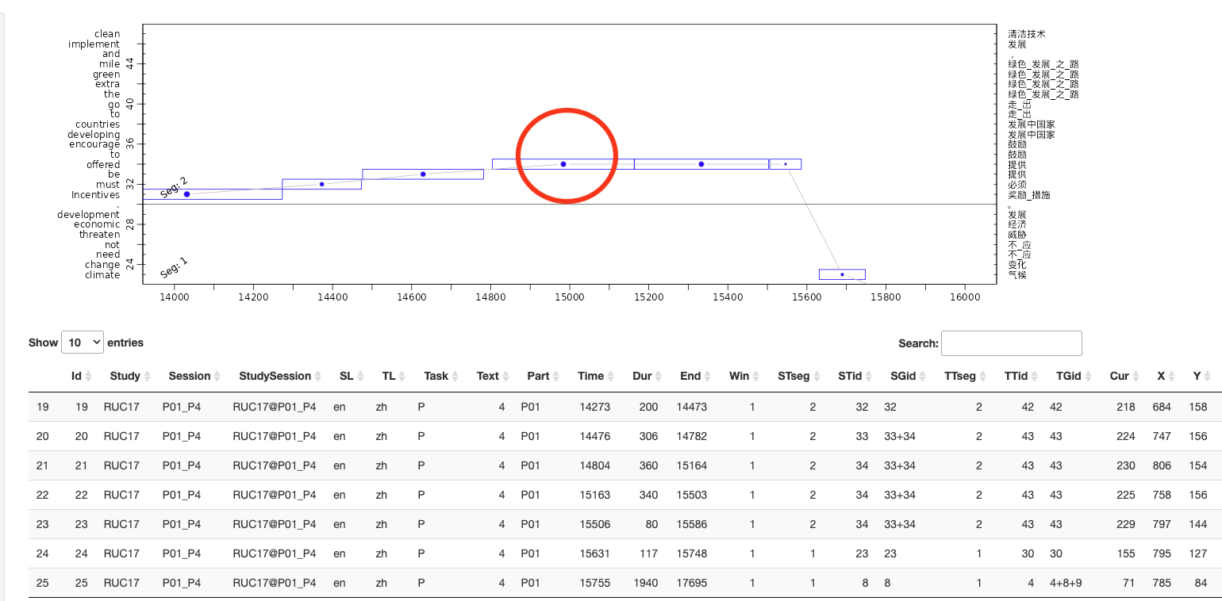
L (linear-reading): 7 (53.85%)
R (re-reading): 3 (23.08%)
O (others): 2 (15.38%)
S (Skimming): 1 (7.69%)
Reasons:
L:
“forward; from the previous word to the next one;”
“no obvious backward regression or large skips”
“it’s a long fixation”
R:
“retention”
“stuck on one section”
O:
” seems linear and then jumps back”
S:
“long forward saccades”
“no regressions”
BASE_DUR (median of the ST fixations durations): 263.0;
BASE_WORD_JUMP (median change in word-ID between two successive fixations in the ST window): 7.5

Slide 3
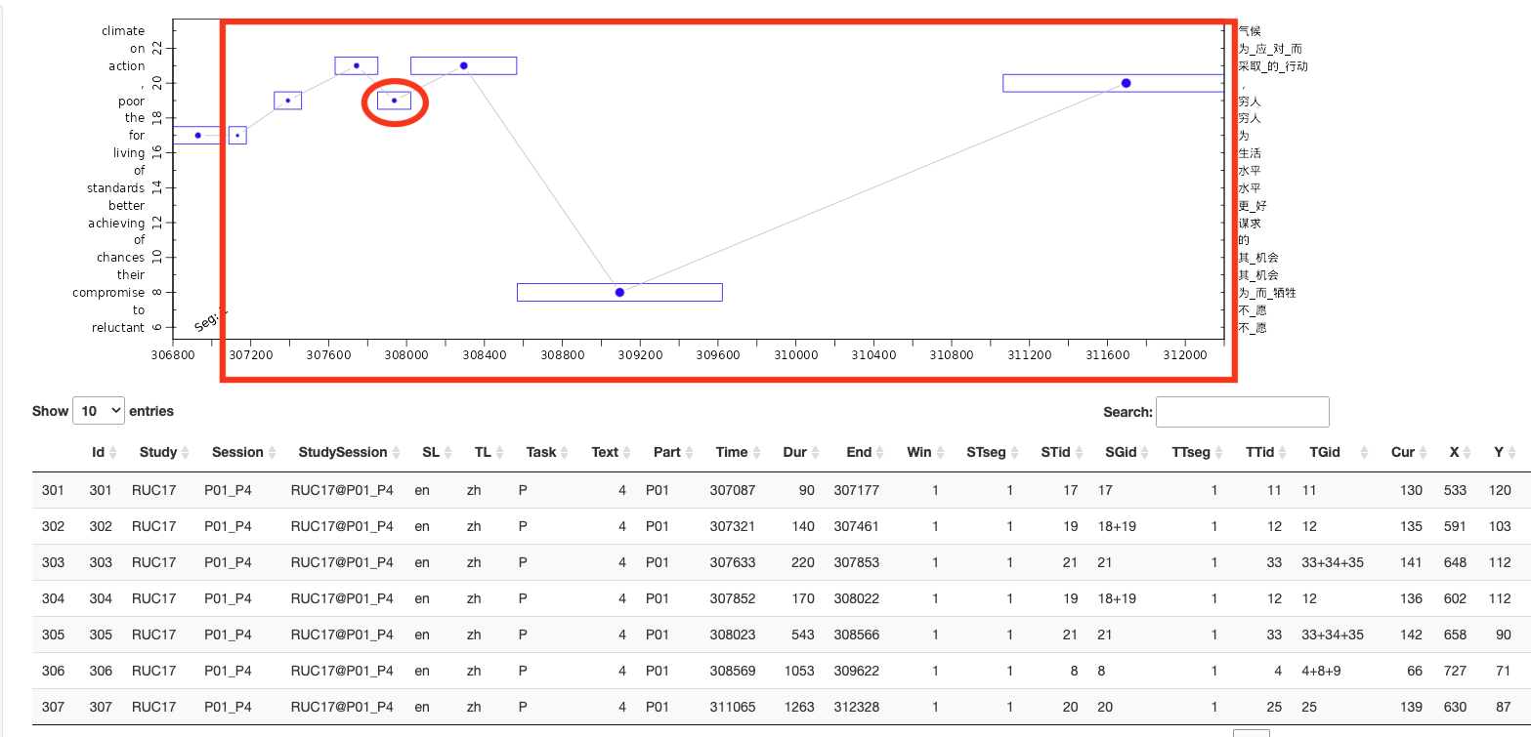
R (re-reading): 8 (61.54%)
S (Skimming): 3 (23.08%)
L (linear-reading): 1 (15.38%)
O (others): 1 (15.38%)
BASE_DUR (median of the ST fixations durations): 263.0;
BASE_WORD_JUMP (median change in word-ID between two successive fixations in the ST window): 7.5

Slide 4
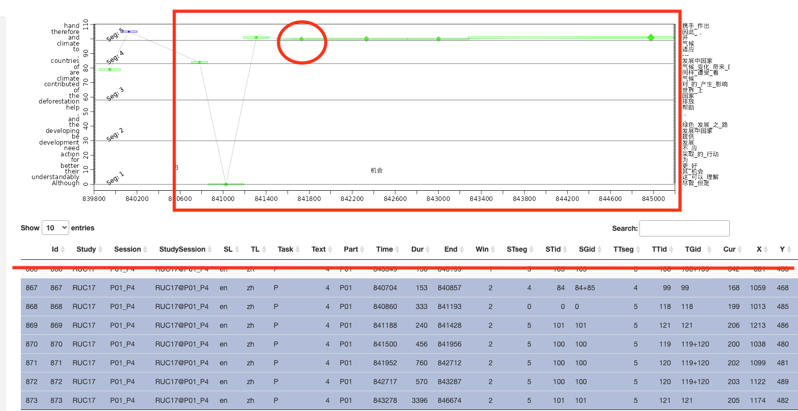
O (others): 6 (46.15%)
L (linear-reading): 5 (38.46%)
R (re-reading): 1 (15.38%)
S (Skimming): 1 (15.38%)
BASE_DUR (median of the TT fixations durations): 263.0;
BASE_WORD_JUMP (median change in word-ID between two successive fixations in the TT window): 5.0

Slide 5
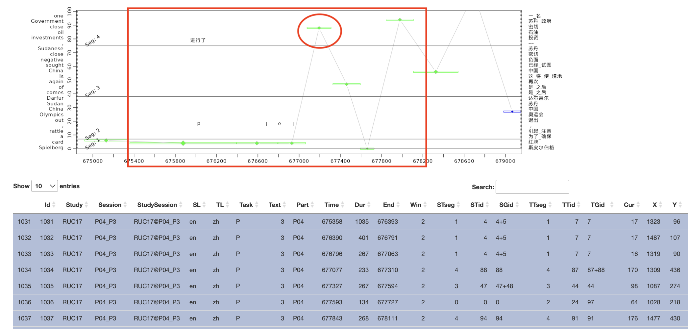
R (re-reading): 5 (38.46%)
S (Skimming): 4 (30.77%)
O (others): 4 (30.77%)
L (linear-reading): 0
BASE_DUR (median of the TT fixations durations): 468.0;
BASE_WORD_JUMP (median change in word-ID between two successive fixations in the TT window): 4.0

Slide 6
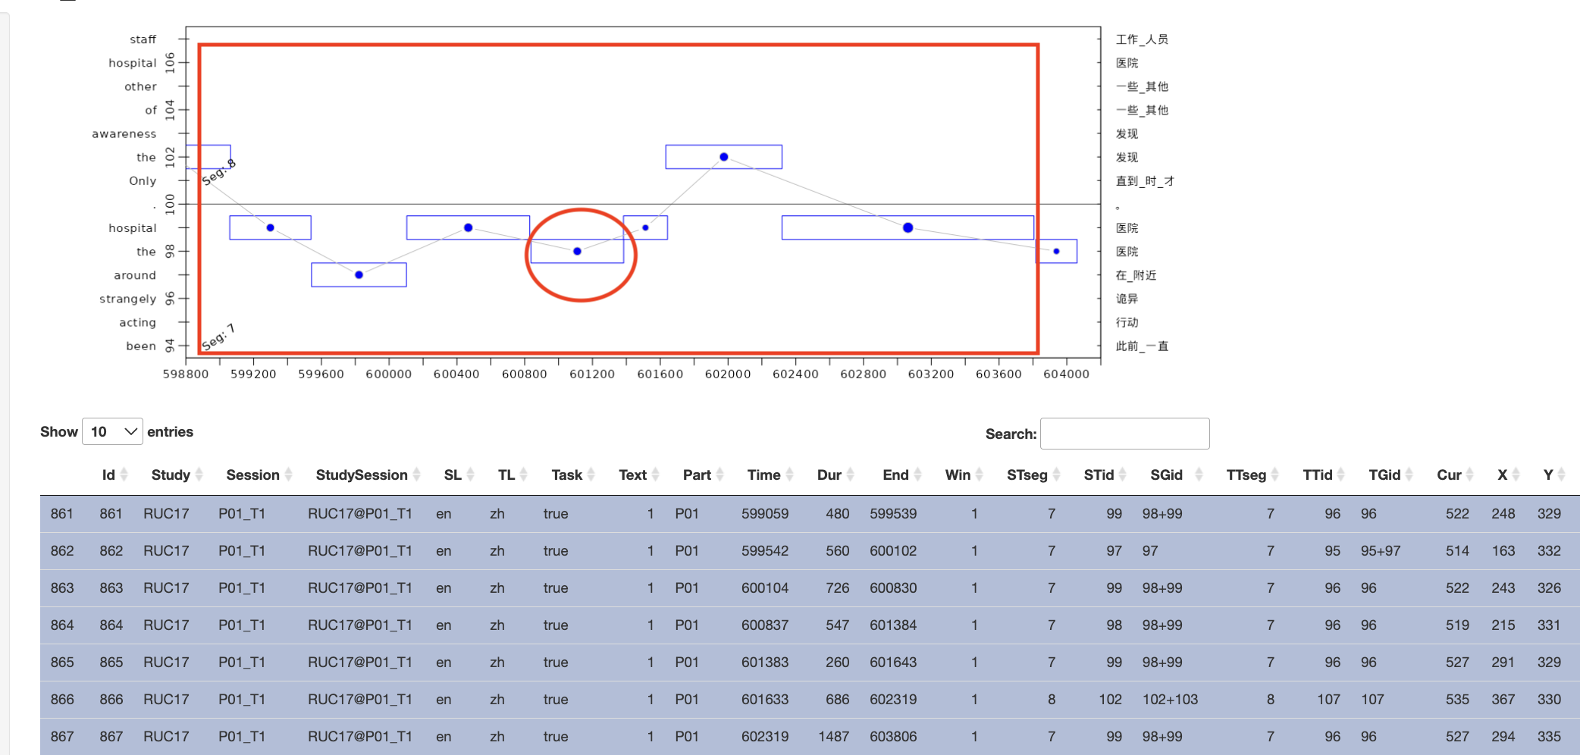
R (re-reading): 8 (61.54%)
O (others): 3 (23.08%)
L (linear-reading): 2 (15.38%)
S (Skimming): 0
BASE_DUR (median of the ST fixations durations): 330.0;
BASE_WORD_JUMP (median change in word-ID between two successive fixations in the ST window): 2.0

Slide 7
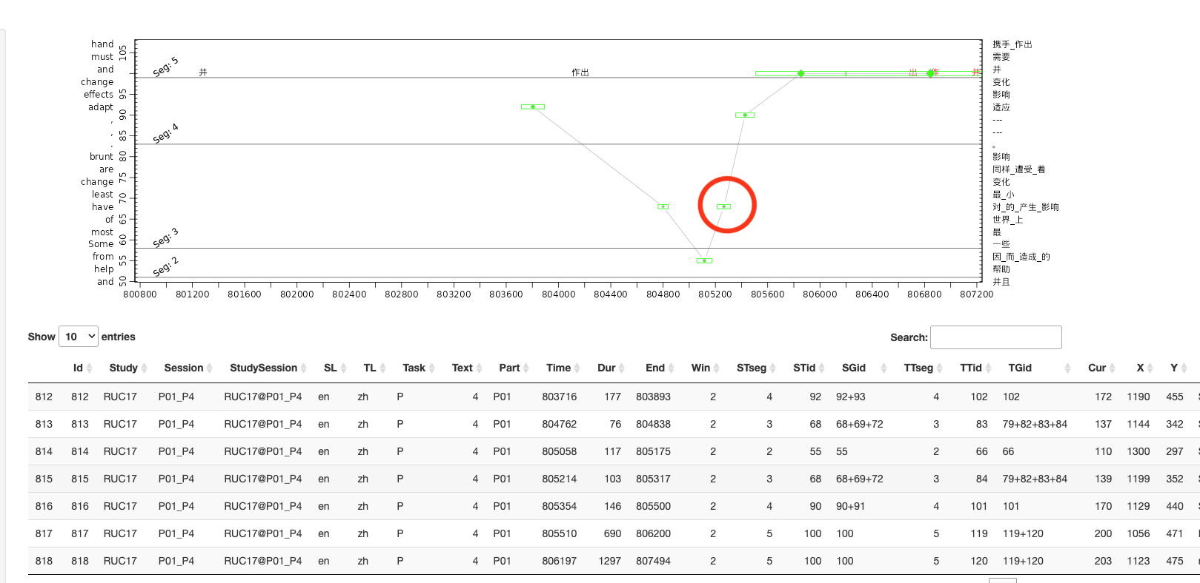
S (Skimming): 7 (53.85%)
R (re-reading): 3 (23.08%)
L (linear-reading): 2 (15.38%)
O (others): 1 (23.08%)
BASE_DUR (median of the TT fixations durations): 263.0;
BASE_WORD_JUMP (median change in word-ID between two successive fixations in the TT window): 5.0

Slide 8
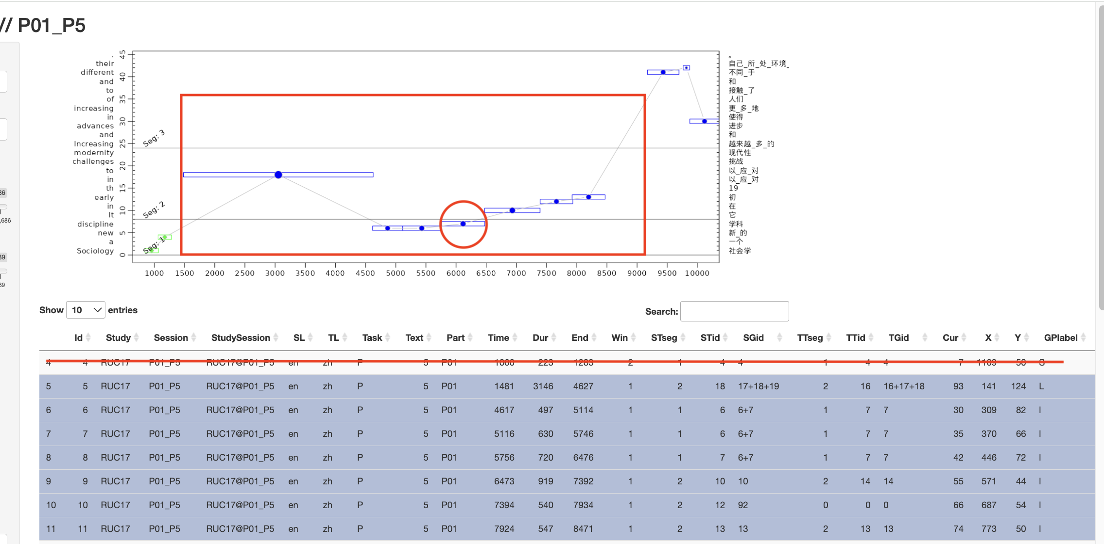
L (linear-reading): 10 (76.92%)
O (others): 2 (15.38%)
R (re-reading): 1 (7.69%)
S (Skimming): 0
BASE_DUR (median of the TT fixations durations): 340.0;
BASE_WORD_JUMP (median change in word-ID between two successive fixations in the TT window): 2.0

Slide 9
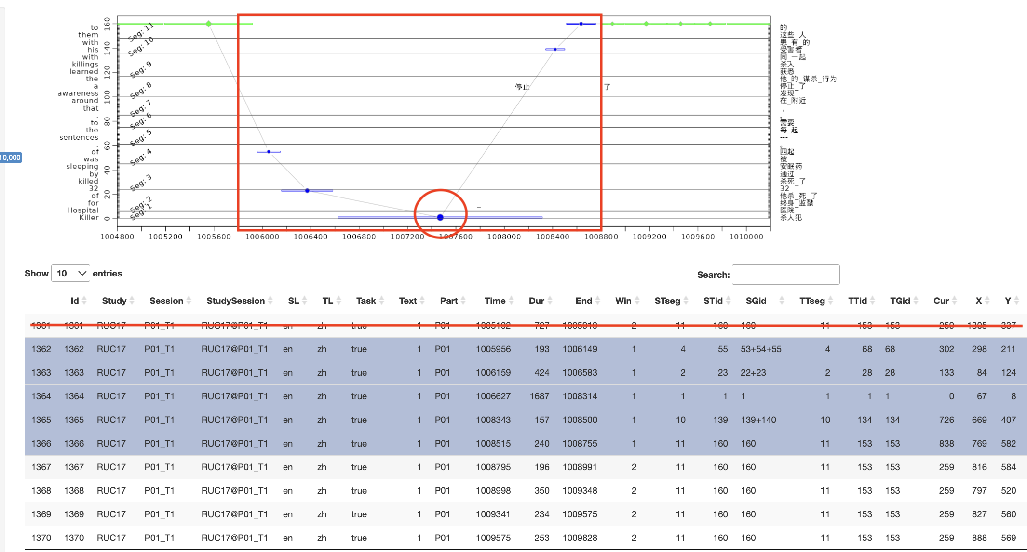
S (Skimming): 4 (30.77%)
O (others): 4 (30.77%)
R (re-reading): 3 (23.08%)
L (linear-reading): 2 (15.38%)
BASE_DUR (median of the ST fixations durations): 330.0;
BASE_WORD_JUMP (median change in word-ID between two successive fixations in the ST window): 2.0

Slide 10
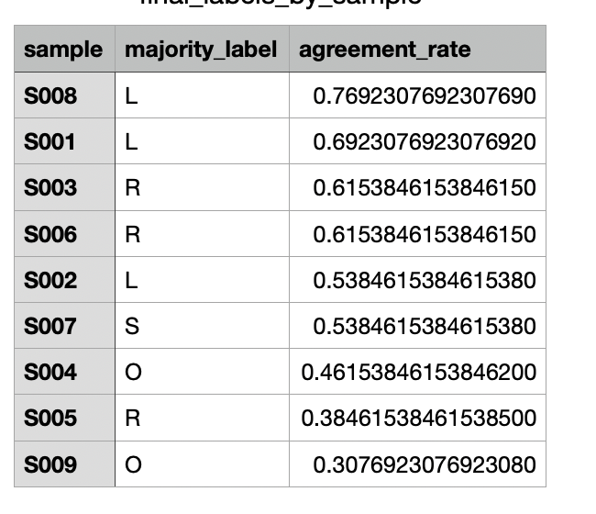

Slide 11
Pairwise agreement rates varied considerably across annotators, with a mean of 37.2% (SD = 7.8%). The highest agreement was 46.3% (J) and the lowest was 20.4% (K). This spread suggests that while some annotators consistently aligned with the majority, others diverged, potentially due to task difficulty or the inherent ambiguity of some gaze patterns

